Slide 1
The Tech Migration to Dallas–Fort Worth Metropolitan Area
Roopam Chakrabarty

Slide 2
Introduction - Business Problem
Dallas–Fort Worth Metropolitan area has quickly become a hub for tech companies, tech departments of Banking and Financial Services organizations and start ups, with companies moving from high cost and denser areas like Bay Area and NY Metro. The migration is not only driving growth and innovation; it is also impacting the real estate market. The objective of this project is to cluster neighborhoods in Dallas–Fort Worth Metropolitan, so that migrating tech workers moving from Bay Area or any other Tech Metro areas across US can make an informed decision on the neighborhood to choose for their future homes.

Slide 3
Who would be interested in this project?
Few of my colleagues moved from the NY Metro area to Dallas–Fort Worth Metropolitan in the recent past, and many more are planning to move to Dallas–Fort Worth Metropolitan in the future. This project will recommend neighborhoods/zip codes based on facilities, thus helping my colleagues to make a prudent decision while choosing a neighborhood/zip code for their future stay based on their lifestyle.

Slide 4
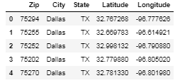
Data
Dallas–Fort Worth metro area consists of 7 major cities with population more than 200,000. These 7 major cities are Arlington, Dallas Fort Worth, Grape Vine, Irving, Lake Dallas, and Plano. These 7 major cities consist of 121 unique zip codes with distinct latitude and longitude. The CSV file was converted into the data frame consist of Zip code, City, State, Latitude and Longitude.

Slide 5
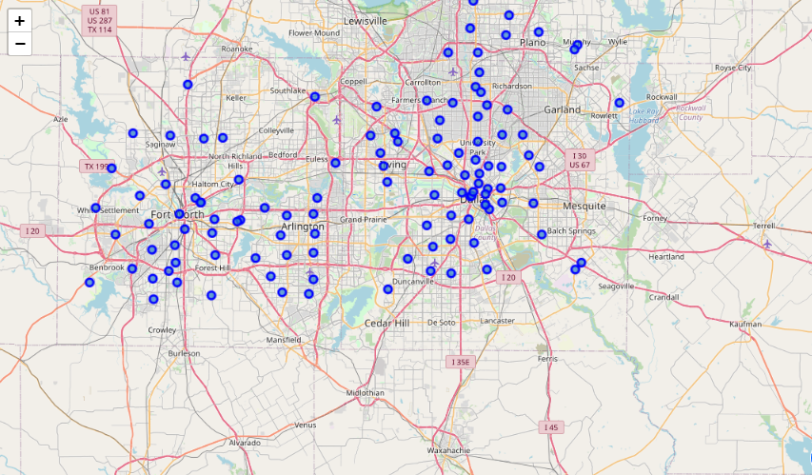
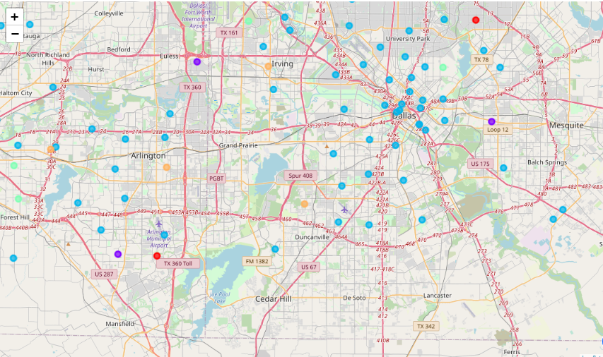
Methodology
After the data exploration and identifying the source of data, we will apply the K-Means machine learning technique for creating clusters of Zip codes representing similar facilities or features.

Slide 6
Result
By looking at the cluster data, we can conclude that Cluster 3 is having most of the zip codes and the best place for settling down due to the wide variety venue categories required for a family to sustain a decent life.
The first cluster (Cluster label 0) is predominantly in an area with Athletics and Sports venue, so will not be suitable for living, but might be good for families into sports.
The second cluster (Cluster label 1) is having Mexican restaurant as the most common venue, so the zip codes part of this cluster might be liked by people loving Mexican food.
The third cluster (Cluster label 2) covers wide variety of categories with malls, convenience stores and supermarket. This is one of the clusters we can certainly recommend for living as some of the zip codes in this cluster are having condominium and apartment communities.
The fourth cluster (Cluster label 3) is having Construction and Landscaping as the most common venue. The zip codes in this cluster might not be suitable for living.
The fifth cluster (Cluster label 4) is also having variety of venue categories for living; also these zip codes are having parks, which can be liked by families and individuals believing in outdoor living.

Slide 7
Recommendation & Conclusion
Based on the data Cluster 3 (Cluster label 2) and Cluster 5 (Cluster label 4) can be recommended for anyone planning to move to Dallas–Fort Worth Metropolitan area.
The project recommended neighborhoods/zip codes based on venue categories retrieved using Four Square API and k-mean clustering. The Clusters selected were based on the categories which were most common and anyone can go thru this detailed report and Notebook to select a zip code based on their personal preference. The analysis and project covered all the aspects of Data Science and Python Libraries such as Pandas, Scikit, Folium to name a few.

Slide 8
Thank You!

